Slide 1


π
Supervised learning
June 2024
π

Slide 2
π
Index
Basics ?
typeDictionary
Pydantic
JsonOutputParser
StructuredoutputParser
Pydanticoutparser
π

Slide 3
π
Supervised Learning
Notes:
Content: https://www.linkedin.com/pulse/chunking-strategies-ai-data-kash-kashyap-0lghe/

Slide 4
π
House Pricing
Regression
Classification
House's Category
RS / $
- affordable
- mid range
- luxury
- ultra luxury
Exact price of House in Numbers
Notes:
Content: https://www.linkedin.com/pulse/chunking-strategies-ai-data-kash-kashyap-0lghe/

Slide 5

π
Weather Forecast
Regression
Classification
Exact Temperature
Predicting weather condition
- sunny
- rainy
- cloudy
In degree Celsius
Notes:
Content: https://www.linkedin.com/pulse/chunking-strategies-ai-data-kash-kashyap-0lghe/

Slide 6
π
Notes:
Content: https://www.linkedin.com/pulse/chunking-strategies-ai-data-kash-kashyap-0lghe/

Slide 7
π
Notes:
Content: https://www.linkedin.com/pulse/chunking-strategies-ai-data-kash-kashyap-0lghe/

Slide 8
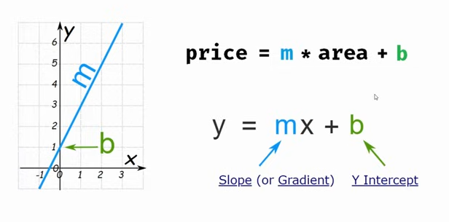
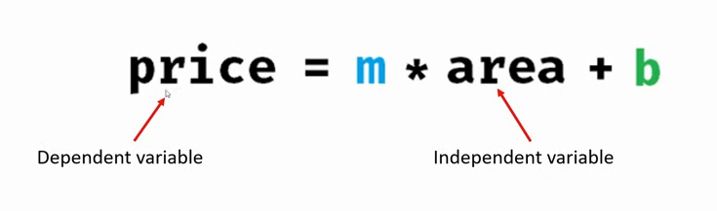
π
Notes:
Content: https://www.linkedin.com/pulse/chunking-strategies-ai-data-kash-kashyap-0lghe/

Slide 9
π
Notes:
Content: https://www.linkedin.com/pulse/chunking-strategies-ai-data-kash-kashyap-0lghe/

Slide 10
π
Notes:
Content: https://www.linkedin.com/pulse/chunking-strategies-ai-data-kash-kashyap-0lghe/

